Slide 1
Conditional Statements
Pankaj Jalote
Distinguished Professor (Founding Director, 2008-18)
IIIT-Delhi

Slide 2
Recap
Program: Seq of computation statements in a Python syntax
Each statement has a precise meaning in Python
Program itself is text – can be created and saved using an editor or an IDE
Program is run by an interpreter – executes each statement as per Python specification
Online runners and editors available for simple prog
IDEs are widely used by programmers / professionals

Slide 3
Statements
Have looked at these statements
Simple input / output statements
Assignment statement
Variables are fundamental – named access to objects
Objects: can be of different types; we have looked at
int – integer, i.e. whole number
float – real numbers (called floating point)
bool - Boolean
Statements use expressions, which may use
Arithmetic operators
Boolean operators
Relational operators
This week:
Conditional execution statements
Iterative statements / loops

Slide 4
If-then-else statement
With Boolean expressions, we also have a the possibility of conditional execution – If statement
Syntax
seq-of-stmts-before-if
if condition: # this is an if-statement seq-1 of statements
else: seq-2 of statements
seq-of-stmts-after-if
Condition: an expression which evaluates to True or False – Boolean or relational or combination
Execution of the if-then-else stmt: If condition evaluates to true, seq-1 is executed, if false seq-2 is executed
After if stmt execution, the stmt following it is executed

Slide 5
If-then statement
Else part can be omitted
Without else, the syntax is
seq-of-stmts-before-if
if condition: seq-1 of stmts
Stmt-seq-after
If condition evaluates to true, seq-1 is executed, after which stmts-after are executed
If condition evaluates to false, seq-1 is not executed – stmts-after if are executed

Slide 6
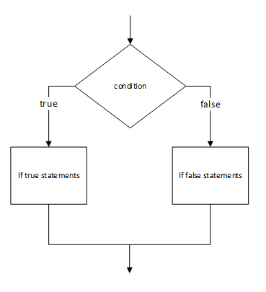
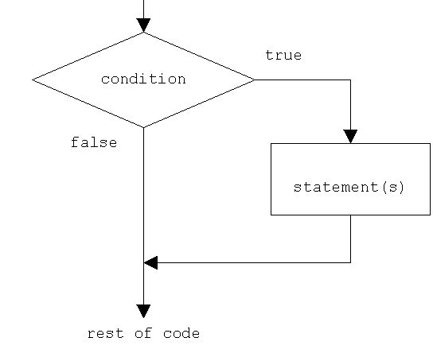
If-then-else and if-then - Control FLow
If-then-else flow
If-then flow

Slide 7
Example: Determine if num is even/odd
# Given an input x, determine if even/odd
x = int (input(“Enter an integer:”) )
if x%2 == 0:
print(“x is even”)
else:
print(“x is odd”)
print(x)
Q: What if the else was omitted?
It will always print “x is odd”

Slide 8
Code Block
If multiple statements to be executed after the condition, or in the else part, all must be indented at the same level
Python uses indentation (<tab> or spaces but not both) (in other programming languages, other methods used, e.g. between { and } )
All the statements to be executed as a block - are indented at the same level
After the block, the indentation reverts back
Block of statements: those that are executed together

Slide 9
Example
For two numbers x and y, determine the square of the bigger number and cube of the smaller one
First find the bigger and smaller nos
Then compute the square of the bigger number and cube of the smaller function and print
Program
a, b = 5, 3
s = a
l = b
if a > b:
s = b
l = a
sq = l*l
cu = s * s * s
print("sq of large, cube of smaller are: ", sq, cu)
Take a minute to discuss with your neighbour these:
Q: Which stmts executed if (a>b) is true: 1, 2, 3, 4, 5, 6, 7, 8, 9
Q: Which stmts if (a>b) is not true : 1, 2, 3, 4, 7, 8, 9

Slide 10
Example of if-then-else
Root of a quadratic equation: ax² + bx + c
We know the formula: (-b +/- sqrt(b²-4ac))/2a
Two roots exist only if (b²-4ac) is positive:
Program should check for this
Do different actions if it positive or if negative

Slide 11
Example - Roots of an Equation
a, b, c = 1, 4, 5
tmp = b*b - 4*a*c
# print("Value of tmp: ", tmp)
if (tmp >= 0):
tmp = tmp**(1 / 2)
x1 = (-b + tmp)/(2*a) # Note () is essential
x2 = (-b - tmp)/(2*a)
print("Roots are: ", x1, x2)
else:
print("It has imaginary roots")
xreal = -b/(2*a)
ximag = (-tmp) ** (1 / 2) / (2*a)
print("Real and img parts: ", xreal, ximag)

Slide 12
Exercises - Practice
Suppose we have a formula:
y = x+1 if x >=0
y = x**2 + 1 if x<0
Write a program to compute this formula - write it on a paper, then compare it with your neighbour

Slide 13
Quiz
Program to print “YES” if the num is an odd multiple of 5, and print “NO” otherwise.
What should be in the blank such that the program behaves as mentioned above.
num = int(input("No: "))
if num%5==0 ___ num%2!=0:
print("YES")
else:
print("NO")

Slide 14
Quiz(Solution)
Solution: and
num = int(input("No: "))
if num%5==0 and num%2!=0:
print("YES")
else:
print("NO")

Slide 15
Conditional statements – more
If statement
If statement with else (if-then-else)
Nesting of if statements
Chaining of ifs with elif

Slide 16
Example – Sequence of Ifs
E.g. for numbers a, b, c, print which of them is the biggest.
Approach 1. Check these conditions:
If (a>b) and (a>c): # Print – largest is a
If (b>a) and (b>c):# b is largest
If (c>a) and (c>b): # c is largest
In this, if first condition is true, others cannot be true – we are unnecessarily checking them
Approach 2. If first condition not true, only then check the second, and check the 3rd only if the second is false
Lets see code for these two

Slide 17
Nesting of if-then-else
Simple if conditions
Nesting - note the alignment
if (a<b) and (a<c):
print("a is the smallest")
if (b<a) and (b<c):
print("b is the smallest")
if (c<a) and (c<b):
print("c is the smallest")
if (a<b) and (a<c):
print("a is the smallest")
else:
if (b<a) and (b<c):
print("b is the smallest")
else:
print("c is the smallest")

Slide 18
Example – elifs
Suppose you are given a digit and you have to print its name
Approach 1: A sequence of if statements checking for 0, 1, …,
But if digit is 0, we don’t need to check for rest – so we put another check in else - then if the digit is not 1, then we need to check for 3, …
This nesting will get deep, as after each check, we need to put another check
An alternative is to use elif (short form for else if)
All elifs are part of the same if statement
There is a final "else", which is executed if none of the conditions above hold true

Slide 19
Nested if-then-else and elif
if d==0:
print("zero")
else:
if d==1:
print("one")
else:
if d==2:
print("two")
else:
if d==3:
print("Three")
else:
print(">3")
if d==0:
print("zero")
elif d==1:
print("one")
elif d==2:
print("Two")
elif d==3:
print("Three")
else:
print(">3")

Slide 20
Quiz
if(a==1):
print("One")
elif(a==2):
print("Two")
else:
print("Other number")
B) if(a==1):
print(“One”)
else:
print(“Other number”)
elif(a==2):
print(“Two”)
C) if(a==1):
print("One")
elif(a>1):
if(a==2):
print("Two")
else:
print("Other number")
D) if(a==1):
print(“One”)
elif(a>1):
elif(a==2):
print(“Two”)
else:
print(“Greater than 2”)
Which of the following sequences of if-else-elif are valid?
Program to print "one", "two" or "other.." based on value of a
Feel free to discuss with your neighbor
2 mts

Slide 21
Quiz(Solution)
Which of the following sequences of if-else-elif are valid?
✅
❌
✅
❌
if(a==1):
print(“One”)
elif(a==2):
print(“Two”)
else:
print(“Other number”)
B) if(a==1):
print(“One”)
else:
print(“Other number”)
elif(a==2):
print(“Two”)
C) if(a==1):
print(“One”)
elif(a>1):
if(a==2):
print(“Two”)
else:
print(“Greater than 2”)
D) if(a==1):
print(“One”)
elif(a>1):
elif(a==2):
print(“Two”)
else:
print(“Greater than 2”)

Slide 22
Example Income Tax Computation
Most countries have progressive tax, E.g.
For income < L1: tax rate is r1
For income between L1 and L2: rate is r2
For income above L2: rate is r3
Compute Income tax; Simple code - it checks 2nd condition every time - a waste
if income<L1:
tax = income*r1
if income>=L1 and income<L2:
tax = L1*r1 + (income-L1)*r2
if income>=L2:
tax = L1*r1 + (L2-L1)*r2 + (income-L2)*r3
print("Tax1: ", tax)

Slide 23
Example code
if income<L1:
tax = income*r1
else:
if income>=L1 and income<L2:
tax = L1*r1 + (income-L1)*r2
else:
if income>=L2:
tax = L1*r1 + (L2-L1)*r2 + (income-L2)*r3
else:
print ("What is this?")
print("Tax: ", tax)
if income<L1:
tax = income*r1
elif income>=L1 and income<L2:
tax = L1*r1 + (income-L1)*r2
elif income>=L2:
tax = L1*r1 + (L2-L1)*r2 + (income-L2)*r3
else:
print ("What is this?")
print("Tax: ", tax)

Slide 24
Quiz
x, a, b = 0, 0, -5
if a>=0:
if b>0:
x=x+1
elif b>-4:
x=x+2
if b>-6:
x=x+3
if b>-7:
x=x+4
else:
x=x+5
if b>-5:
if a>0:
x=x+1
elif a>1:
x=x+2
else:
x=x+4
print(x)
Consider the code given on the right and answer the following questions:
What would be the final value of x?

Slide 25
Quiz
Consider the code given on the right and answer the following questions:
a.) What would be the final value of x?
Ans. 7
x, a, b = 0, 0, -5
if a>=0:
if b>0:
x=x+1
elif b>-4:
x=x+2
if b>-6:
x=x+3
if b>-7:
x=x+4
else:
x=x+5
if b>-5:
if a>0:
x=x+1
elif a>1:
x=x+2
else:
x=x+4
print(x)

Slide 26
Conditional Assignment
We often have simple conditional value evaluation:
if c1:
x = a
else:
x = b
Python provides a short form
x = a if c1 else b
x = expr1 if c1 else expr2 # general form
Eg for assigning smallest of two numbers
s = a if a<b else b
Also called the ternary operator

Slide 27
Quiz
What would be the output of the code given on the right?
a, b = 10, 20
x = b-a if a < b else a-b
print(x)

Slide 28
Quiz
What would be the output of the code given on the right?
Ans. 10 [i.e x = b-a]
a, b = 10, 20
x = b-a if a < b else a-b
print(x)

Slide 29
pass statement
Sometimes you don't want to do anything, and you want to explicitly state that
pass statement allows that
if c:
pass
else:
stmt
Pass is a valid statement - you can put it anywhere a statement is allowed

Slide 30
Summary - if stmt
Conditional statement is a fundamental type of statement; has a few forms: if-then-else, if-then, if-elif
For each then/else condition there is a block of code which is executed if condition is true/false
Code block can contain conditional statement also, leading to nested if-then-else; can also have sequence of if statements
Be careful when conditionals are nested or used in sequence - to make sure that all conditions are covered and no undesired overlap
Conditional assignment is a short form of a simple if statement - made into a one line stmt

Slide 31
Feedback on Next Class
To plan for next lecture, please let us know your preference for attending the next lecture
Green: In-class
Yellow: Undecided
Red: Online

Slide 32
Minute Paper
Please take 1-2 mts to look at your notes and reflect on what you learned today
Then fill the MP - both what you understood, and what you are not clear on

Slide 33
Quiz
What would be the output of the code given on the right?
Hint: Apply the rules of conversion between types
a, b, c = 1, 2, 3
if a + b + c:
print("1")
else:
print("2")

Slide 34
Quiz
What would be the output of the code given on the right?
Ans. 1
[Recall : Any non-zero value or a non-empty string: boolean value is True]
a, b, c = 1, 2, 3
if a + b + c:
print("1")
else:
print("2")

